Slide 1

When you go small, go Bayes!
Prathiba Natesan Batley
Professor

Slide 2
Disclaimers

Slide 3
Single case or n-of-1 designs
Interrupted time-series designs
Experimental designs
Small samples
Randomization or gathering large data are impossible or inappropriate. e.g. specialized populations such as individuals with disabilities, genomic markers
Becoming more widely recognized as alternatives to RCTs

Slide 4
The ABAB Design

Slide 5
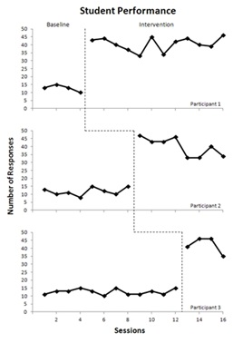
The Multiple Baseline Design
Notes:
Cooper, J. O., Heron, T. E., & Heward, W. L. (2007). Applied behavioral analysis (2nd edition). Upper Saddle River, NJ: Pearson Education, Inc.
Available: https://qcpages.qc.cuny.edu/~dfienup/multiplebaselineinfo.html
Note the tutorial for creating your own graphs (next slide)

Slide 6
Applications
Pilot and proof of concept work to guide intervention development
Outliers in RCTs and other “Group Designs”
What works for the group vs the individual
Example from Nature
Notes:
RCTs are preferred by funding agencies, statisticians, journal editors, policymakers – because it makes a good case for causality. But are they really THE BEST procedure for establishing causality? I am going to begin with some medical examples because this will help me drive home the point more easily.
I will begin with a quote in Nature by Nicholas Schork: “Every day, millions of people are taking medications that will not help them. In the US alone the top ten highest grossing drugs help between 1 in 25 to 1 in 4 people who take them. “ In fact several drugs only benefit 1 in 50 people while also causing side effects in others.

Slide 7
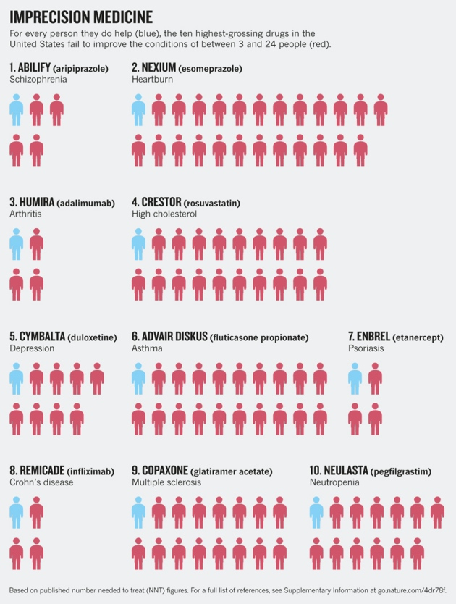
Example from Nature
# medicine helps
# fails to help
Notes:
This chart that shows how many people are really helped by the medicine they take (blue)

Slide 8
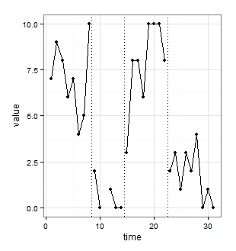
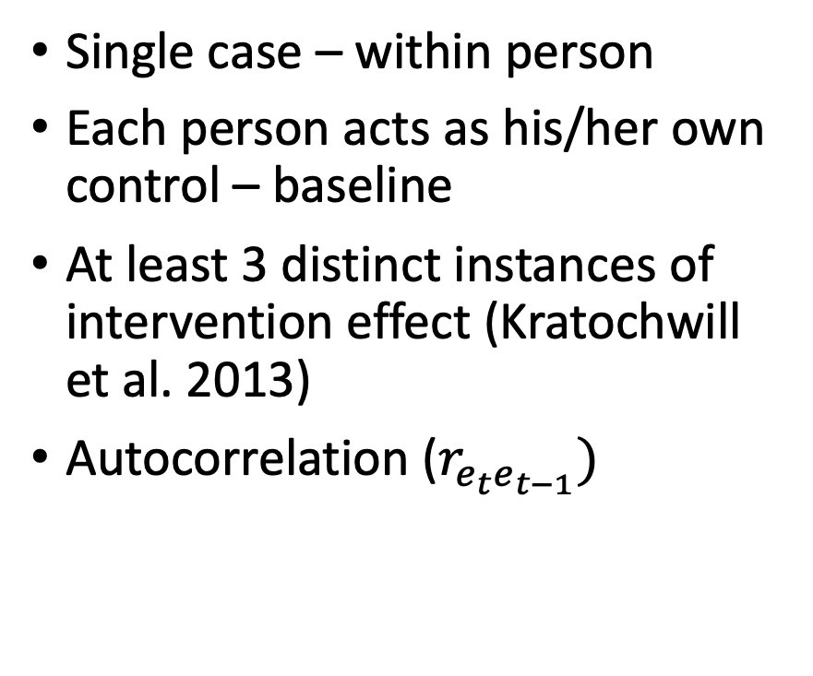
Another ABAB
Single case – within person
Each person acts as his/her own control – baseline
At least 3 distinct instances of intervention effect (Kratochwill et al. 2013)
Autocorrelation ($r_{e_{t}e_{t−1}})$

Slide 9
Return to Baseline
Baseline
Replication of Intervention
Causality
Intervention

Slide 10
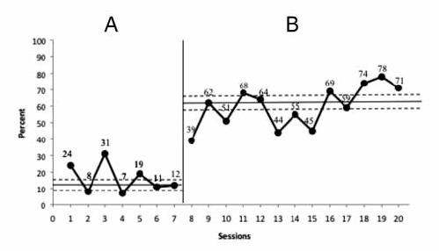
Visual Analysis of SCDs
Examine immediacy, consistency across phases, level, trend, and variability
Difficult to measure the magnitude of the effect
Reliability across visual analysts?
Autocorrelation - confounds
Stable baseline consensus

Slide 11
Statistical Analysis in SCDs
Percent non-overlap
Improvement rate difference
Regression – MLM (recent)
Effect sizes and SCEDs
https://files.eric.ed.gov/fulltext/ED562991.pdf
http://www.singlecaseresearch.org/
https://www.jepusto.com/what-is-tau-u/
Bayesian (recent)

Slide 12
Problems with Statistical Analysis of SCDs
Less data (4-6 data points per phase)
Large Standard Errors
Autocorrelation
Violation of assumptions (α, β↑)
Difficult to model → ML
Distributional concerns
Meta-analysis – standardized effect sizes

Slide 13
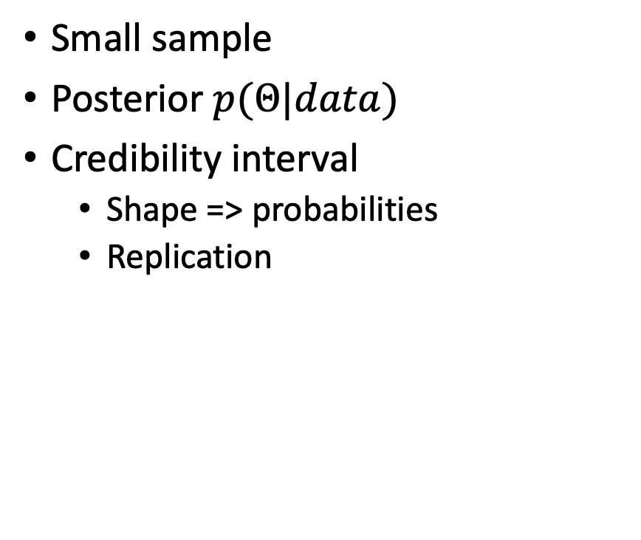
Why Bayesian?
Small sample
Posterior $p(Θ|data)$
Credibility interval
Shape => probabilities
Replication
Flexible modeling
Autocorrelation
Data types
Notes:
CI – hypothetical repetitions

Slide 14
WWC Standards

Slide 15
Technical documentation
Three demonstrations of experimental effect
Across cases
Across phases
Level – mean score of the data within a phase
Trend – slope of the best fitting line for data within a phase
Variability – fluctuation of data within a phase
Effect size
Immediacy – immediate treatment effect when introduced

Slide 16
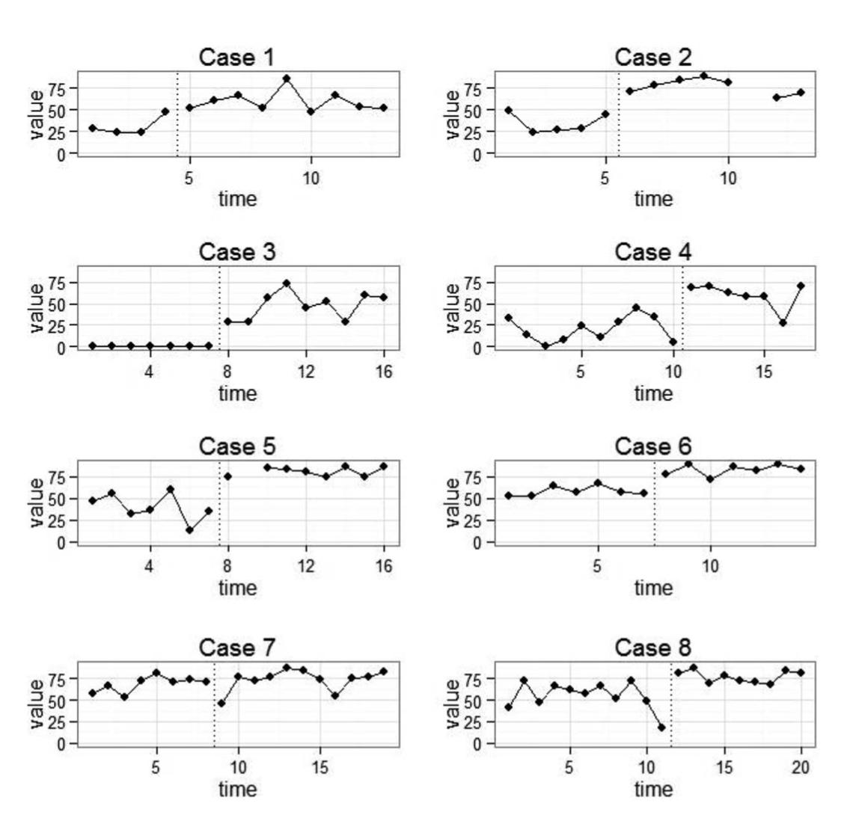
Technical documentation
Document consistency of level, trend, variability within phase
Document immediacy, effect size, consistency of data across phases
Proportion overlap vs other effect sizes
Strong and moderate evidence – effect size

Slide 17
Technical documentation
Immediacy
Visual analysis: change in level between the last three data points in one phase and the first three data points of the next.
More rapid effect – more convincing that the outcome measure changed due to manipulation of the condition
Delayed effects

Slide 18
This workshop
Immediacy
Model estimation

Slide 19
Immediacy

Slide 20
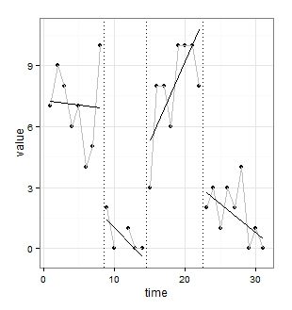
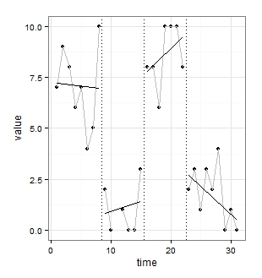
Which graph is correct?

Slide 21
Which graph is correct?
In the absence of information about when a treatment stops taking effect, we are left with assuming our data measure what we think they represent

Slide 22
Bayesian Unknown Change-point Model (BUCP)
Assumes that the change-points are unknown
Confirms the absence or the length and the presence of lag/washout effects
Lets the data speak for themselves
When the change is estimated accurately -> first evidence of causality; validity check
Automatically models different functional relations between the IV and the DV across phases
Notes:
an objective procedure for dealing with a latent feature of the data: the actual point at which the trajectory of observations change.

Slide 23
Method
An objective procedure for dealing with a latent feature of the data: the actual point at which the trajectory of observations change.
Change-points can be estimated with less uncertainty
Analyzing their posterior shape gives more information about both the change-point and other parameters

Slide 24
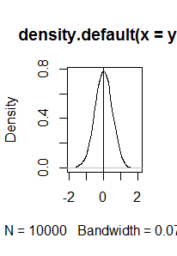
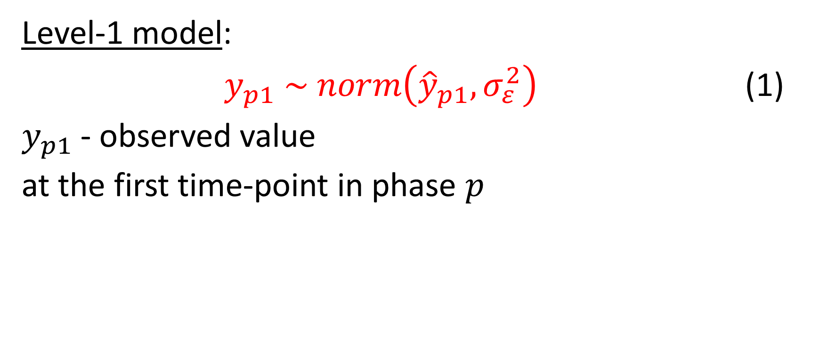
Model
Level-1 model:
$y_{p1} \sim norm\left({\hat{y}}_{p1},σ_{ε}^{2}\right)$ (1)
$y_{p1}$- observed value
at the first time-point in phase $p$

Slide 25
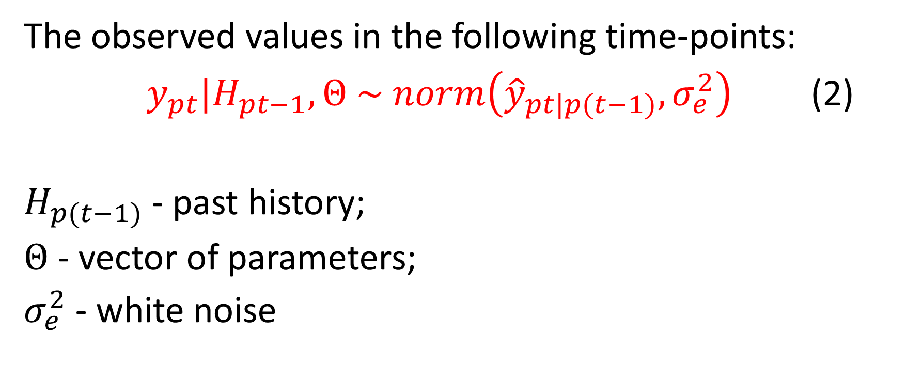
Model
The observed values in the following time-points:
$y_{pt}|H_{pt−1}, Θ \sim norm\left({\hat{y}}_{pt|p(t−1)},σ_{e}^{2}\right)$ (2)
$H_{p(t−1)}$ - past history;
$Θ$ - vector of parameters;
$σ_{e}^{2}$ - white noise

Slide 26
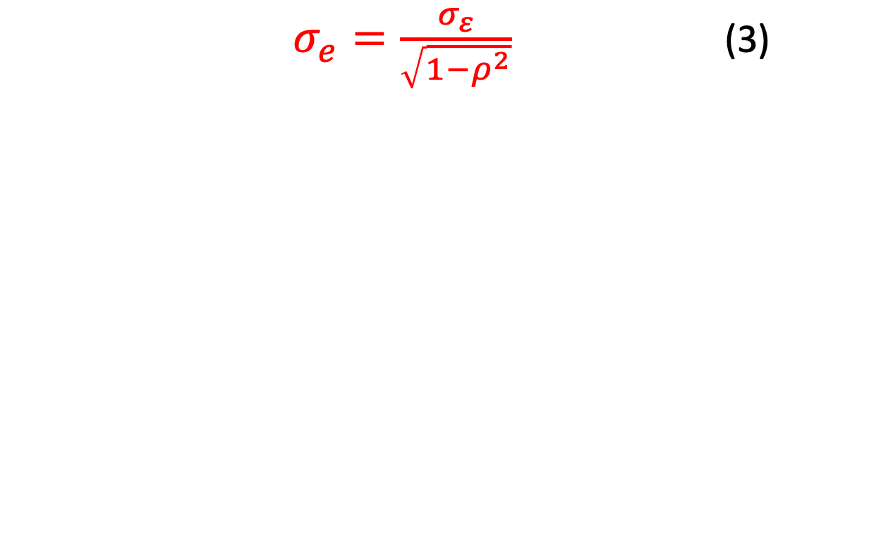
Model
Random Error
$σ_{e}=\frac{σ_{ε}}{\sqrt{1−ρ^{2}}}$ (3)
White noise
Autocorrelation

Slide 27
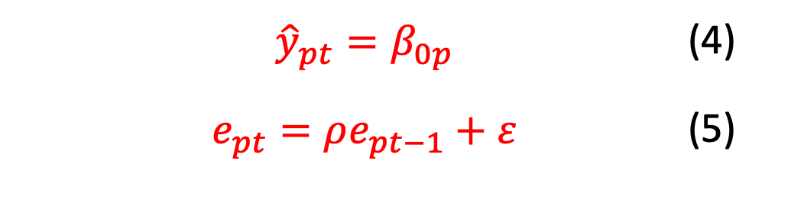
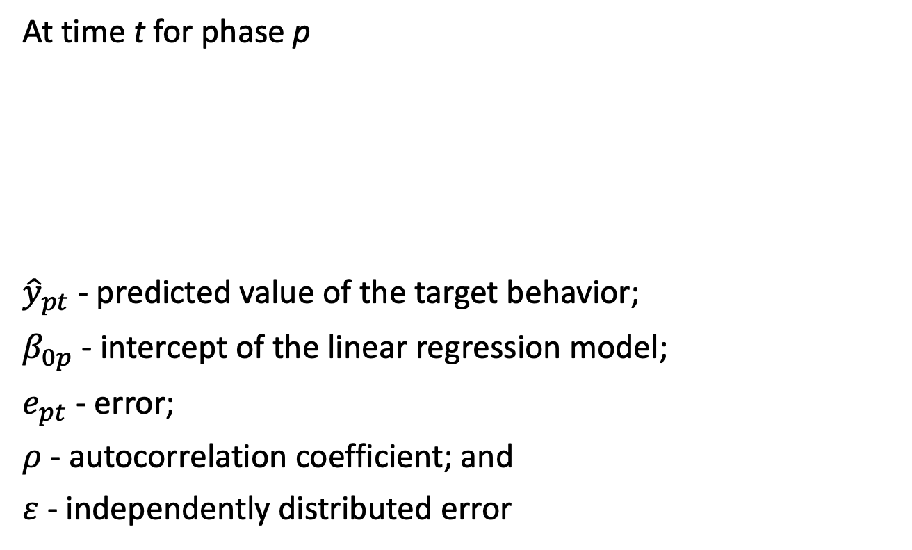
Model
At time t for phase p
${\hat{y}}_{pt}$ - predicted value of the target behavior;
$β_{0p}$ - intercept of the linear regression model;
$e_{pt}$ - error;
$ρ$ - autocorrelation coefficient; and
$ε$ - independently distributed error
 | $${\hat{y}}_{pt}=β_{0p}$$ | (4)
 | $$e_{pt}=ρe_{pt−1}+ε$$ | (5)

Slide 28
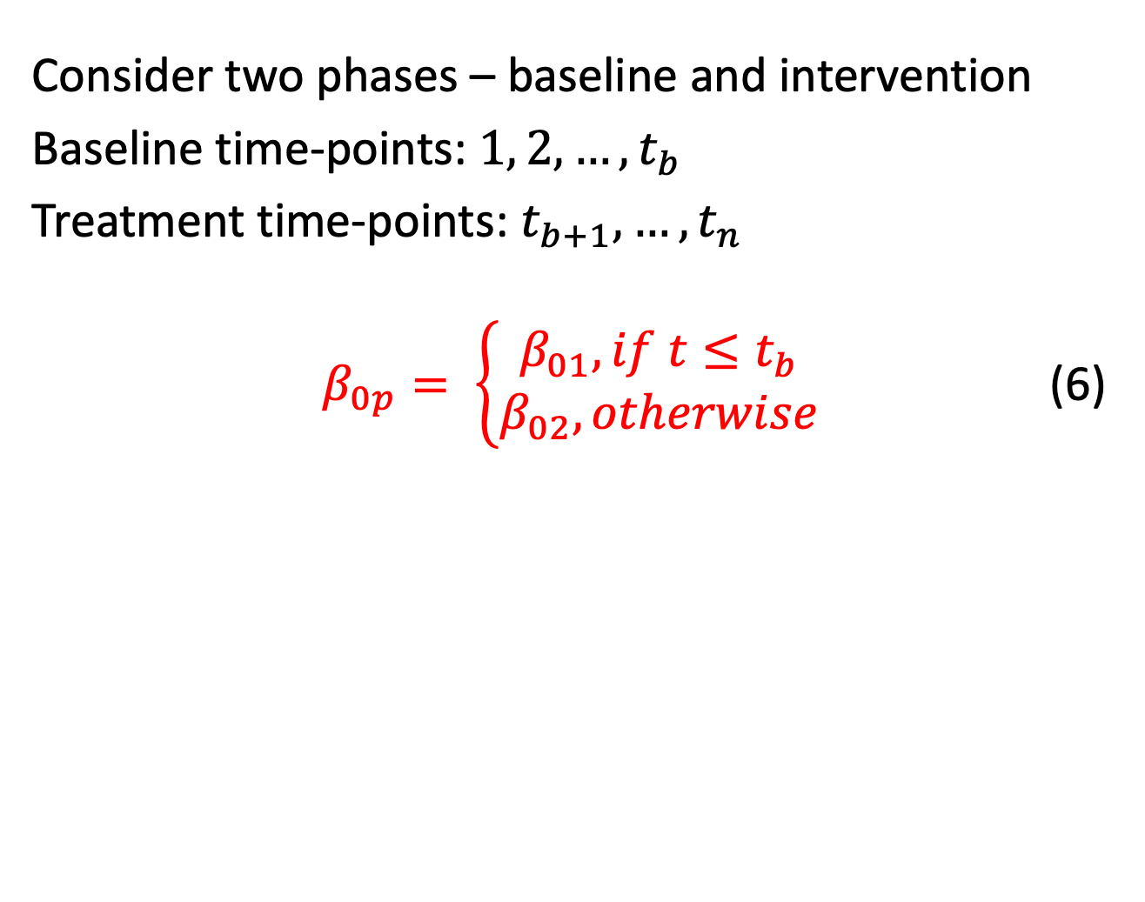
Model
Consider two phases – baseline and intervention
Baseline time-points: ${1, 2,…,t}_{b}$
Treatment time-points: $t_{b+1}, …, t_{n}$
$β_{0p}= \left\{\begin{matrix}β_{01}, if t≤t_{b} \\ β_{02}, otherwise\end{matrix}\right.$ (6)
$β_{0p}= β_{01}∗dummy+β_{02}∗(1−dummy)$ | (7)

Slide 29
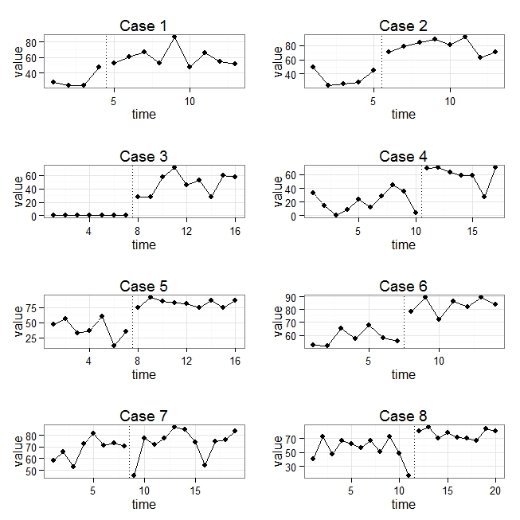
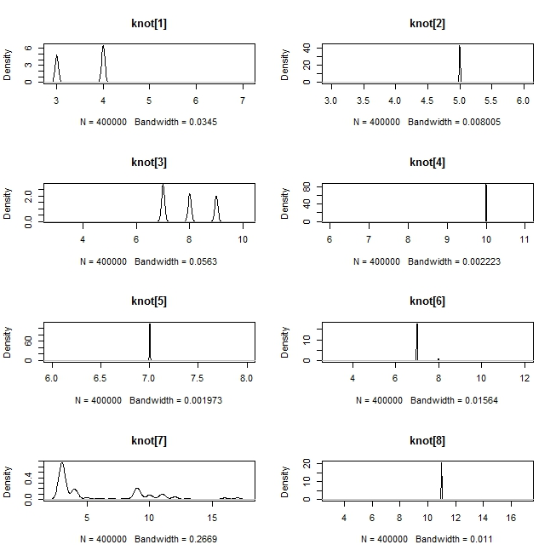
Example

Slide 30
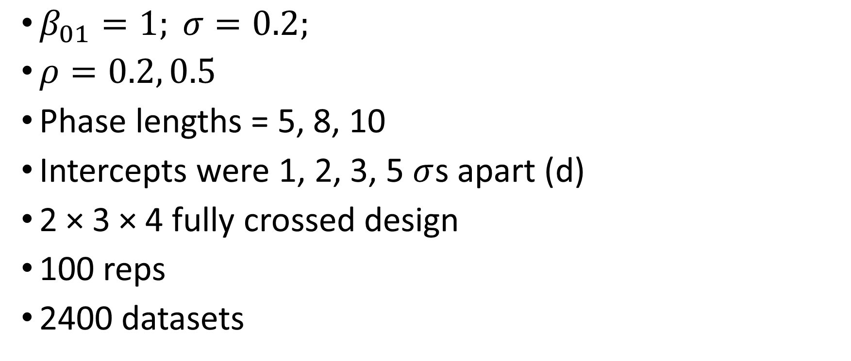
Simulation (Natesan & Hedges, 2017)
$β_{01}=1; σ=0.2;$
$ρ=0.2, 0.5$
Phase lengths = 5, 8, 10
Intercepts were 1, 2, 3, 5 $σ$s apart (d)
2 × 3 × 4 fully crossed design
100 reps
2400 datasets

Slide 31
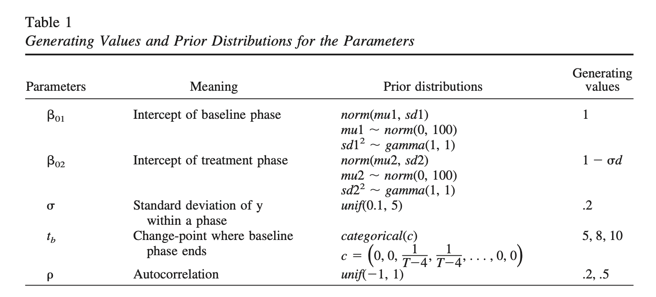
Simulation (Natesan & Hedges, 2017)

Slide 32
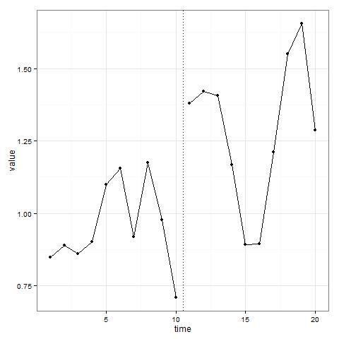
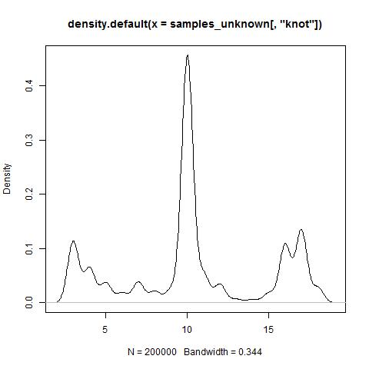
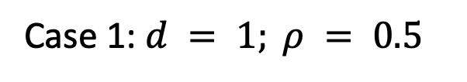
Large Posterior SD
Case 1: $d = 1; ρ = 0.5$

Slide 33
Large Posterior SD
Always examine the shape of the posterior and not just its descriptive statistics

Slide 34
Results
Requires d >=3 and #observations/phase >= 8 when using extremely generic priors
More informed priors => better accuracy
Let us take a look at what happened with real data

Slide 35
Laski et al (1988)

Slide 36
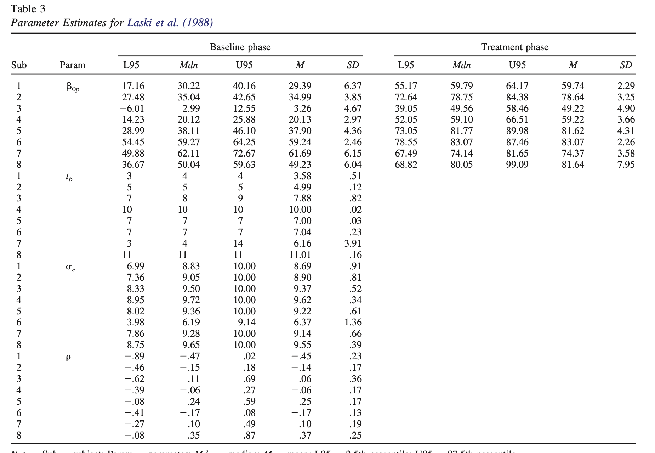

Slide 40
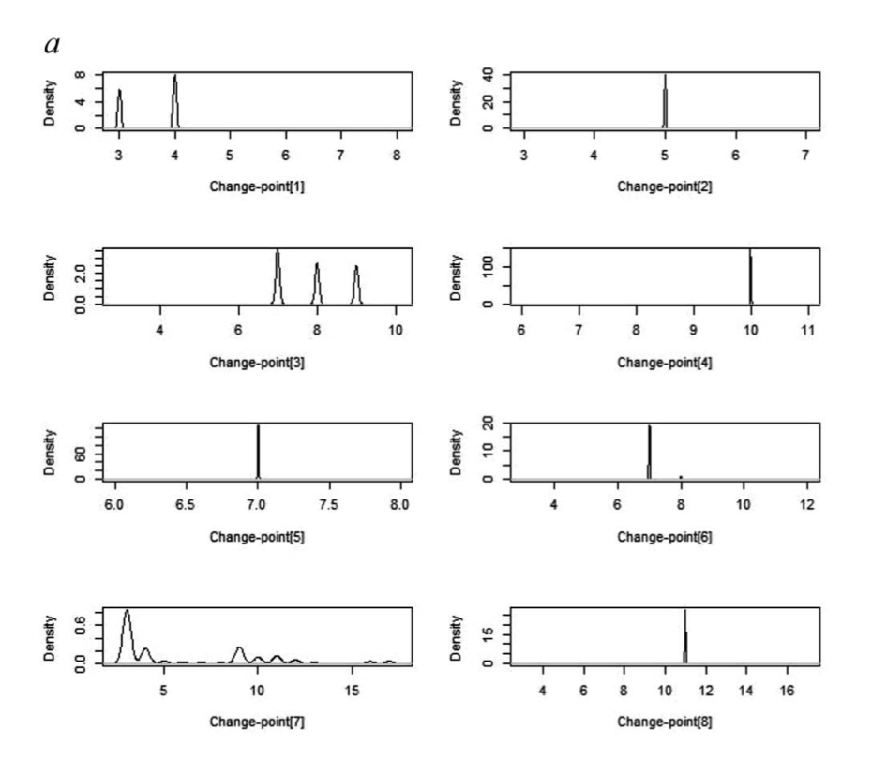
Posterior densities

Slide 41
Chicken and egg problem
When change-point estimates are inaccurate
Latency
Unclear patterns – weaker evidence of treatment effect
Interpret effect sizes with caution
Potential lack of consistency within phases

Slide 42
Chicken and egg problem
When change-point estimates are accurate
Clear evidence of immediacy => treatment effect
Potential consistency within phases
Effect size is a good representation of the treatment effect

Slide 43
In sum…
Treats the change-point as unknown
Confirmatory approach
Lag and washout effects
Smaller SE
Check validity of the data

Slide 44
Bayesian methods allow the researcher to examine the shape of the posterior distribution. This gives a clearer evaluation of the quality of the estimates.

Slide 45
Other distribution types and challenges
The model presented can accommodate other distribution types, data types, functional relationships between time and the dependent variable, and even additional explanatory variables (higher level models).
Refer to Natesan Batley, Hedges, and Minka (2020) for multiple change-points – cannot use the same algorithm for multiple change-points problem
https://github.com/prathiba-stat/Multiple-Unknown-Changepoints-Model

Slide 46
Demonstration

Slide 47
Demonstration
https://github.com/prathiba-stat/Small-is-beautiful
DV | Phase
7 | 1
7 | 1
6.75 | 1
4.5 | 2
4.8 | 2
4.4 | 2
4.25 | 2
3.75 | 2
3.5 | 2

Slide 48
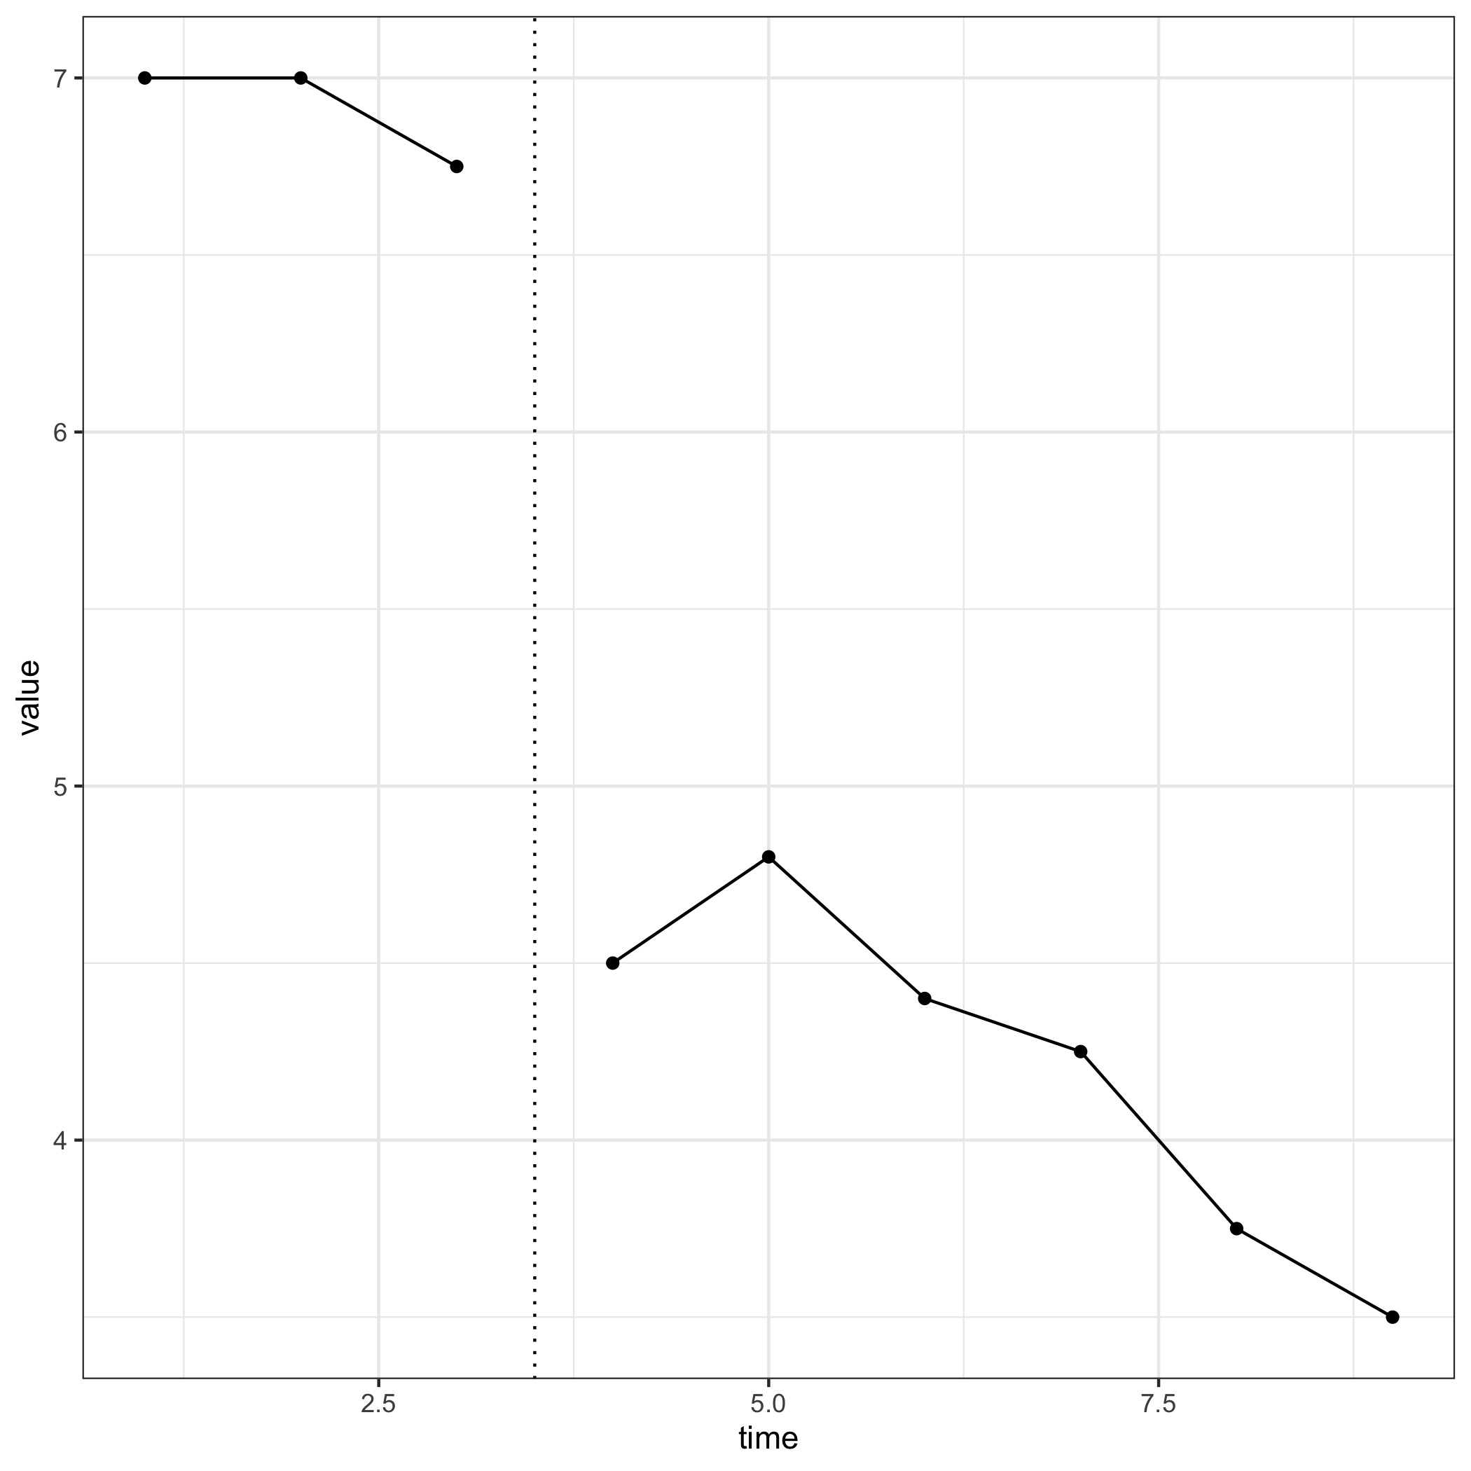
AB dataset

Slide 49
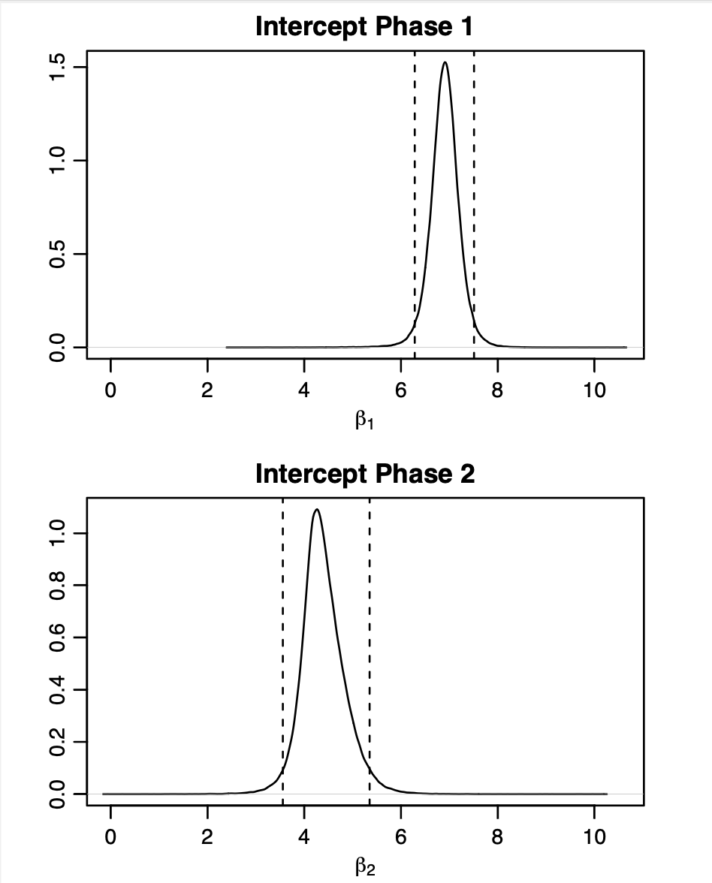
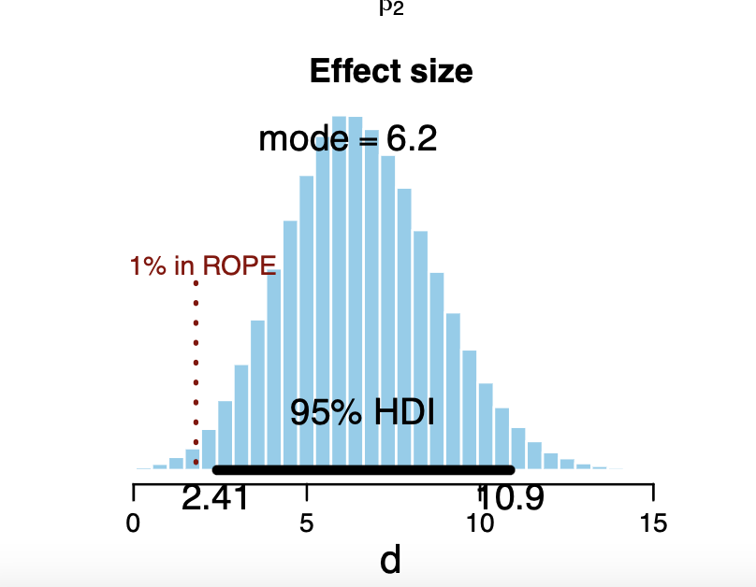
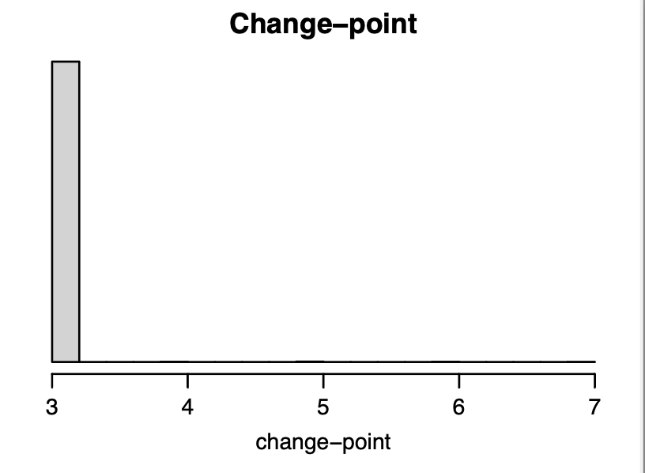
AB dataset

Slide 50
MBD
https://github.com/prathiba-stat/BUCP/blob/master/BUCP-Github.R
MBD no slope-Coulter - The effects of preteaching key words on accuracy and fluency in connected text
Learning disability and reading two grade levels below their same age peers

Slide 51
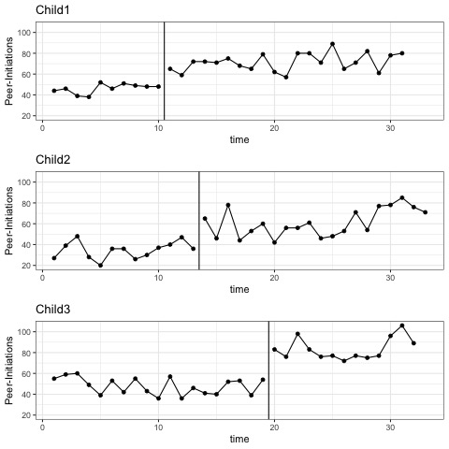
MBD

Slide 52
MBD

Slide 53
MBD

Slide 54
MBD
No variation in the estimates

Slide 55
Model complexity and selection

Slide 56
Model complexity in SCEDs
Level
Trend
Autocorrelation
Interruption – time series
Short time series

Slide 57
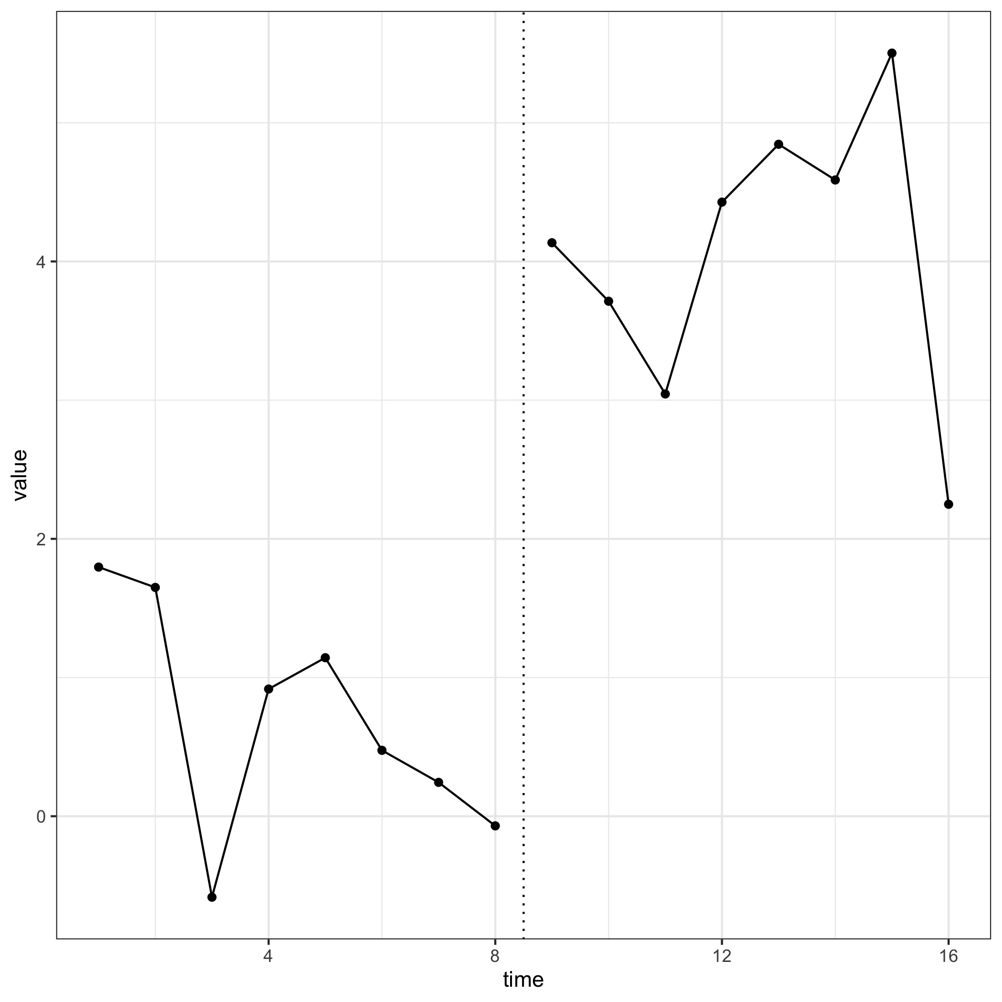
Model complexity in SCEDs
Is there a trend in these data?

Slide 58
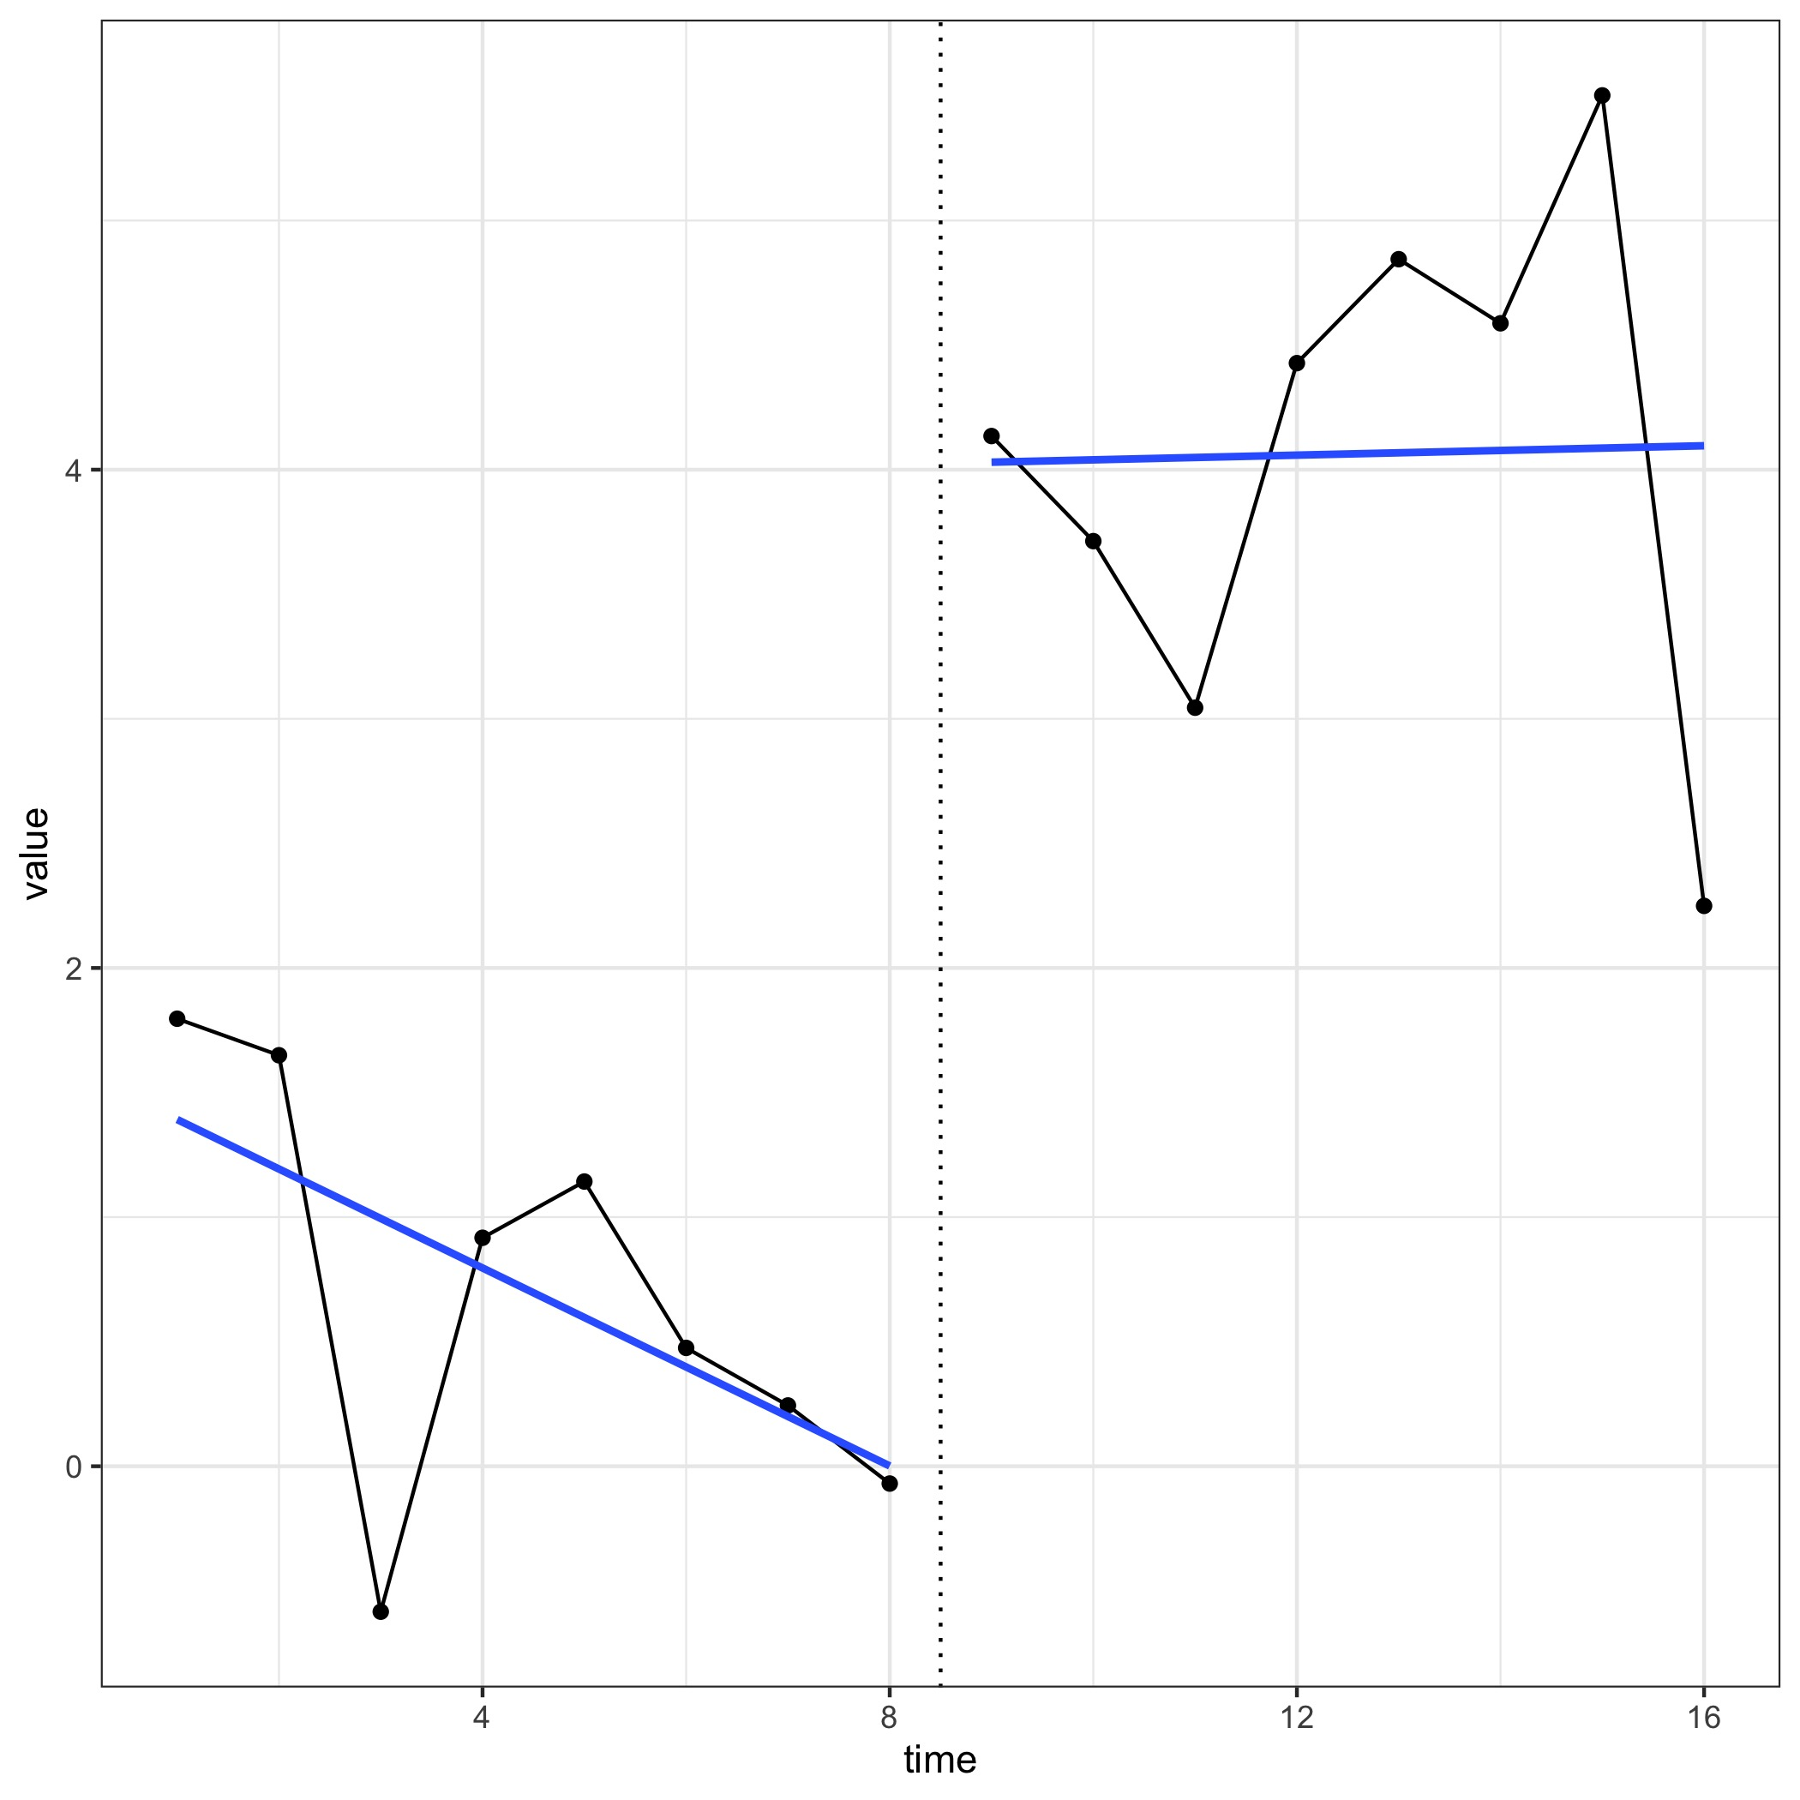
Model complexity in SCEDs
How about now?
How much of the ”trend” is due to autocorrelation vs slope?

Slide 59
Model complexity in SCEDs
Simulated data
Phase 1 slope was 0
Phase 2 slope was -0.08

Slide 60
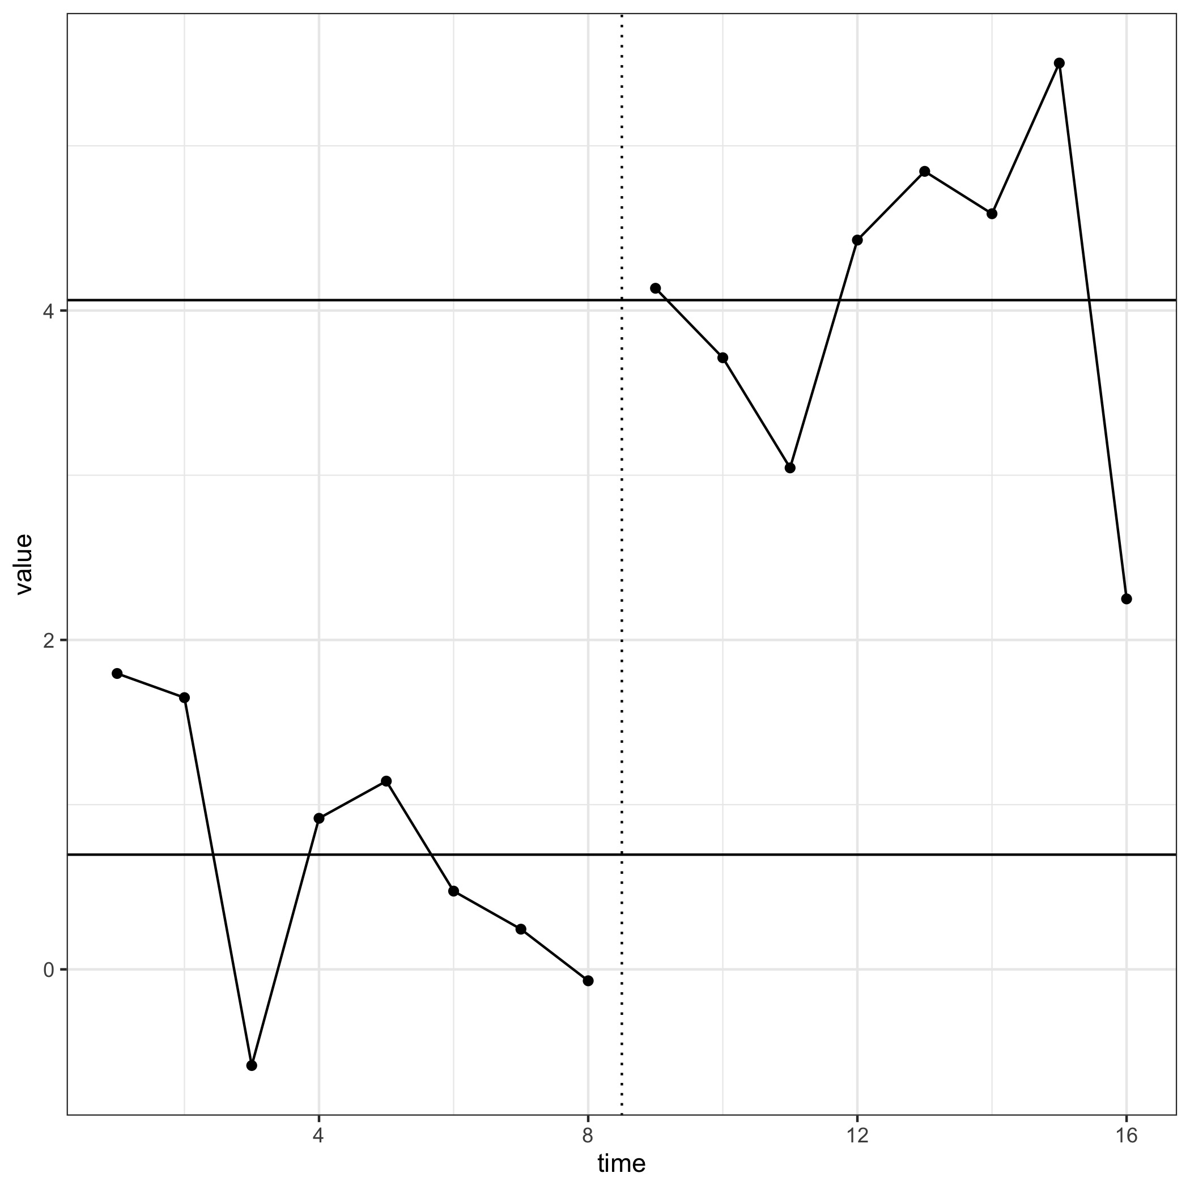
Levels only vs Levels and slopes

Slide 61
Big question
Model that best fits the data?
Model that is truest to the population/hypothesized model?
Model that is simplest?

Slide 62
Four Possible Models
 |  | Slope
 |  | No | Yes
Autocorrelation | No | IO (intercepts only) | SI (slopes and intercepts only)
 | Yes | NS (No slopes) | SA (slopes and autocorrelations)

Slide 63
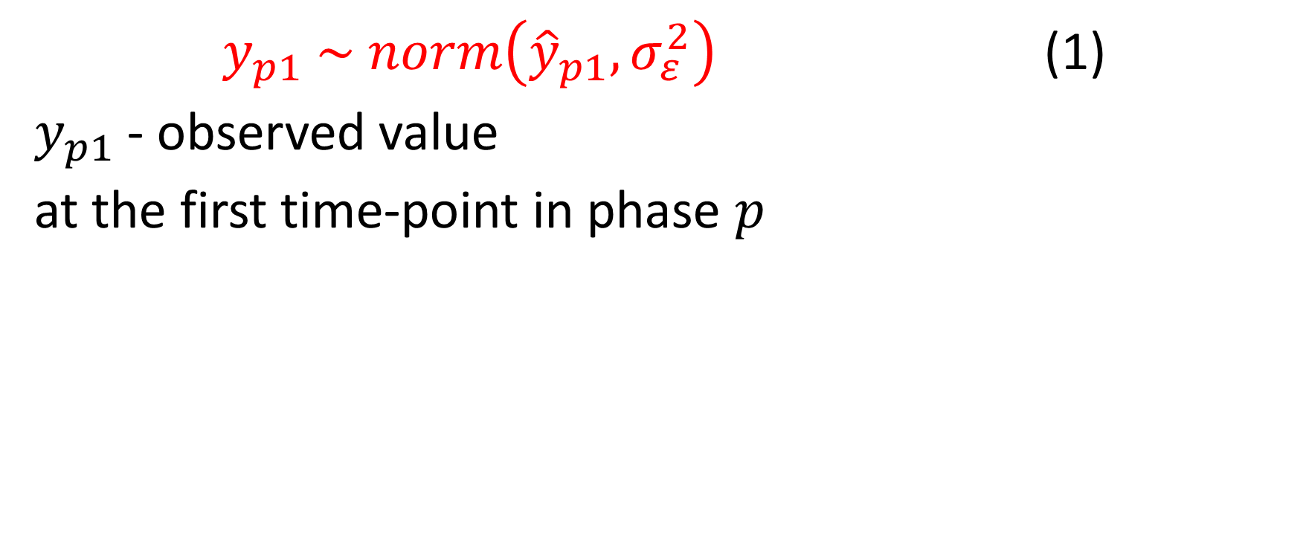
Model
$y_{p1} \sim norm\left({\hat{y}}_{p1},σ_{ε}^{2}\right)$ (1)
$y_{p1}$- observed value
at the first time-point in phase $p$

Slide 64
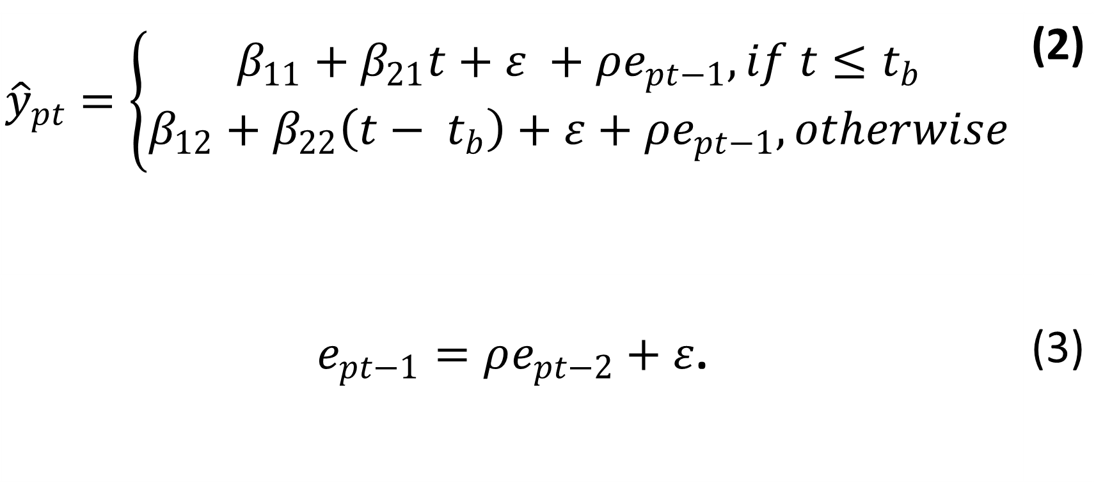
Full Model (SA)
$${\hat{y}}_{pt}=\left\{\begin{aligned}β_{11}+β_{21}t+ε +ρe_{pt−1}, if t≤t_{b} \\ β_{12}+β_{22}\left(t− t_{b}\right)+ε+ρe_{pt−1}, otherwise\end{aligned}\right.$$ | (2)
$e_{pt−1}=ρe_{pt−2}+ε$. | (3)

Slide 65
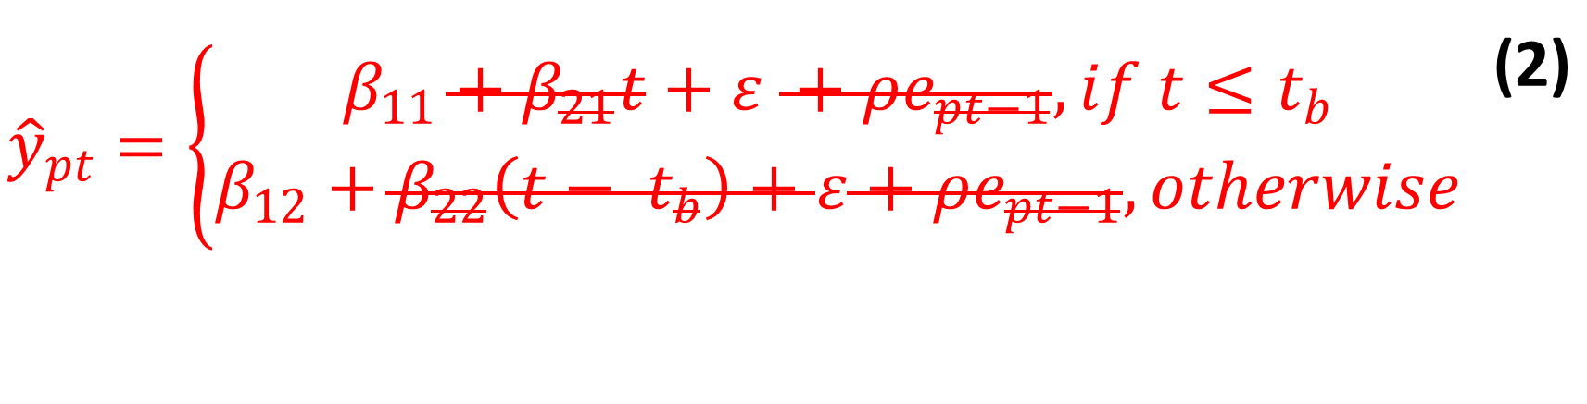
Intercepts only Model (IO)
$${\hat{y}}_{pt}=\left\{\begin{aligned}β_{11}+β_{21}t+ε +ρe_{pt−1}, if t≤t_{b} \\ β_{12}+β_{22}\left(t− t_{b}\right)+ε+ρe_{pt−1}, otherwise\end{aligned}\right.$$ | (2)

Slide 66
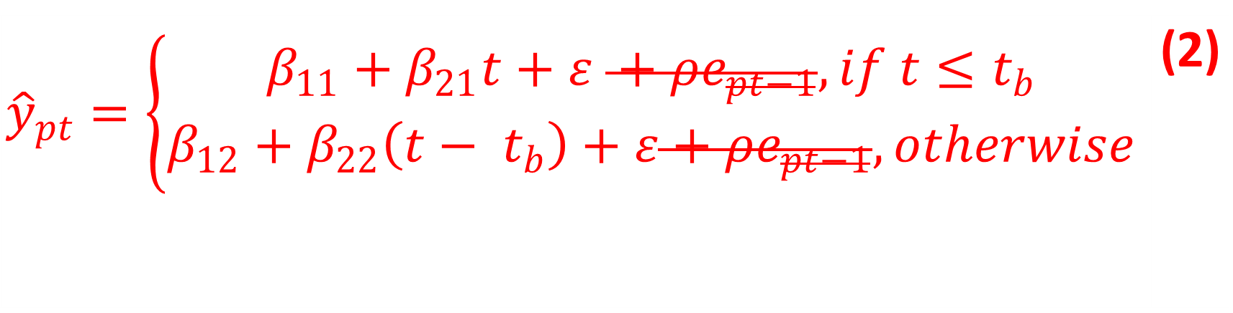
Slopes and Intercepts only (SI)
$${\hat{y}}_{pt}=\left\{\begin{aligned}β_{11}+β_{21}t+ε +ρe_{pt−1}, if t≤t_{b} \\ β_{12}+β_{22}\left(t− t_{b}\right)+ε+ρe_{pt−1}, otherwise\end{aligned}\right.$$ | (2)

Slide 67
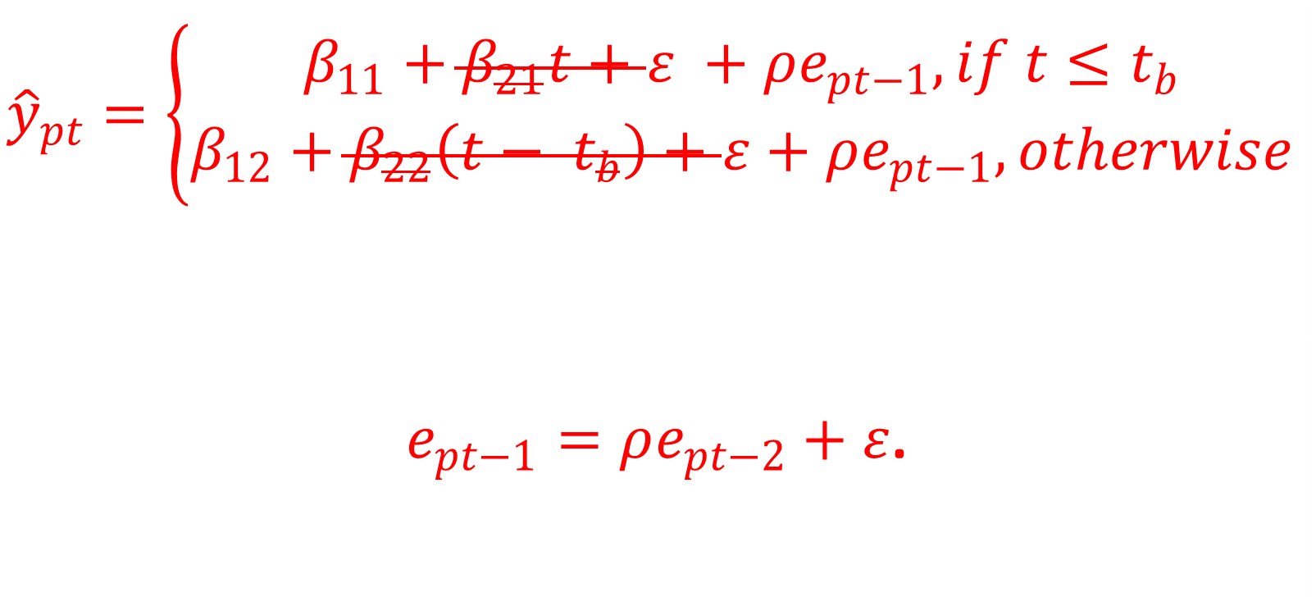
No Slopes Model (NS)
$${\hat{y}}_{pt}=\left\{\begin{aligned}β_{11}+β_{21}t+ε +ρe_{pt−1}, if t≤t_{b} \\ β_{12}+β_{22}\left(t− t_{b}\right)+ε+ρe_{pt−1}, otherwise\end{aligned}\right.$$
$e_{pt−1}=ρe_{pt−2}+ε$.

Slide 68
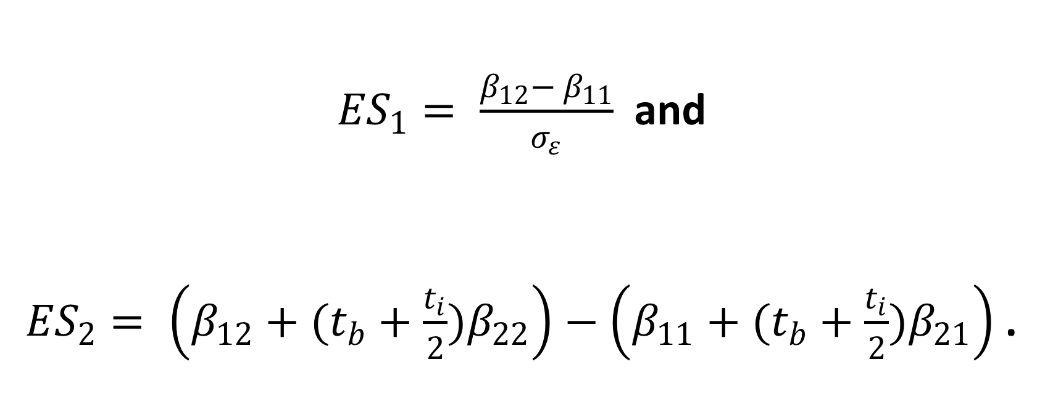

Intercept (${ES}_{1}$) and Slope (${ES}_{2}$) Effect Sizes
${ES}_{1}= \frac{β_{12}− β_{11}}{σ_{ε}}$ and
${ES}_{2}= \left(β_{12}+(t_{b}+\frac{t_{i}}{2})β_{22}\right)−\left(β_{11}+(t_{b}+\frac{t_{i}}{2})β_{21}\right)$.

Slide 69
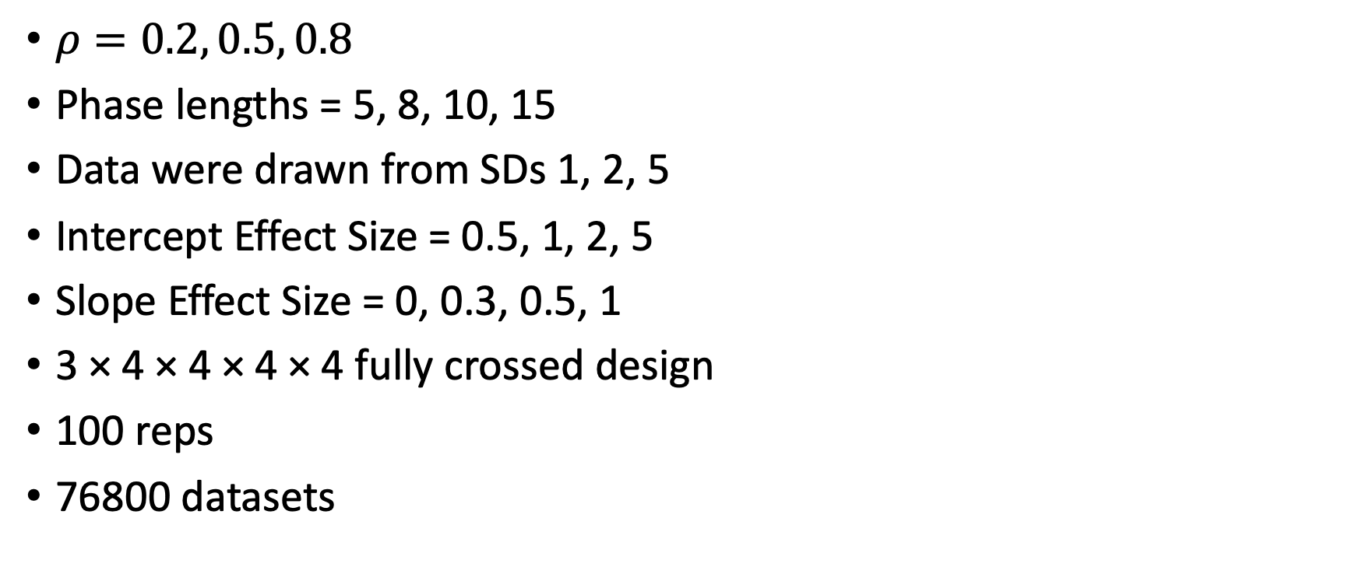
Simulation
$ρ=0.2, 0.5, 0.8$
Phase lengths = 5, 8, 10, 15
Data were drawn from SDs 1, 2, 5
Intercept Effect Size = 0.5, 1, 2, 5
Slope Effect Size = 0, 0.3, 0.5, 1
3 × 4 × 4 × 4 × 4 fully crossed design
100 reps
76800 datasets

Slide 70
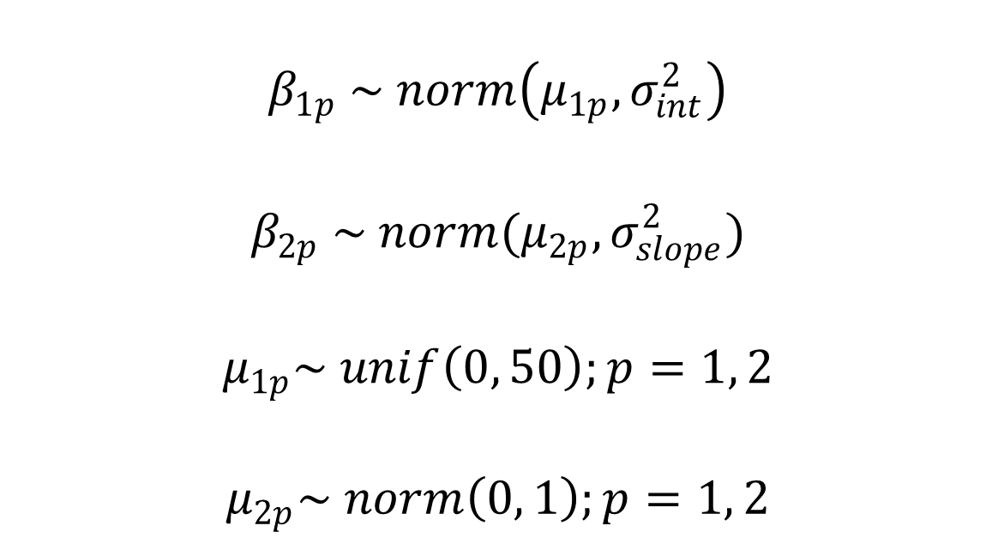
Priors
$$β_{1p} \sim norm\left(μ_{1p}, σ_{int}^{2}\right)$$
$$β_{2p} \sim norm(μ_{2p}, σ_{slope}^{2})$$
$$μ_{1p}\sim unif\left(0, 50\right);p=1, 2$$
$$μ_{2p}\sim norm\left(0, 1\right);p=1, 2$$

Slide 71
Simulation
DVs – RMSE and coverage rates of intercepts, slopes, both effect sizes, autocorrelations, and standard deviations
0-coverage rates were also calculated
If both ρ and slope CIs contain zero…

Slide 72
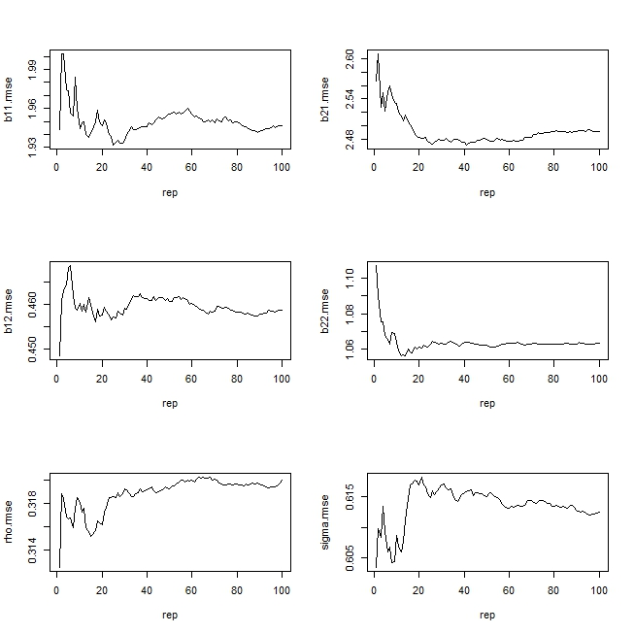
RMSEs versus replications for all parameter estimates for the SA model. Note the scale of the y-axis

Slide 73
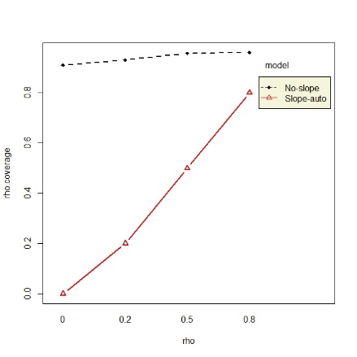
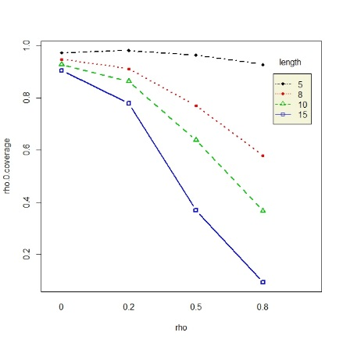

Slide 75
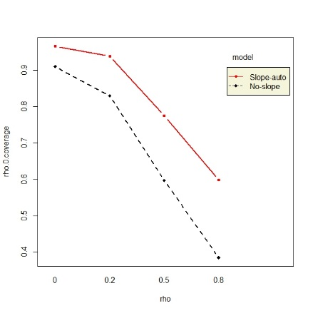

Slide 76
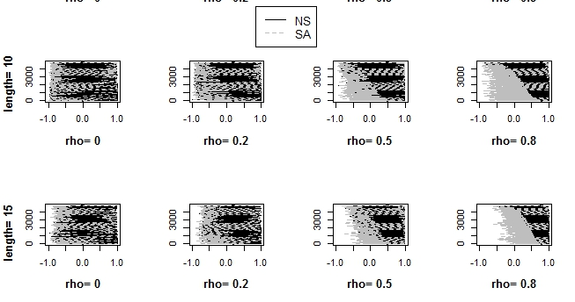
Credibility intervals of autocorrelation estimates showing shorter CIs for NS

Slide 77
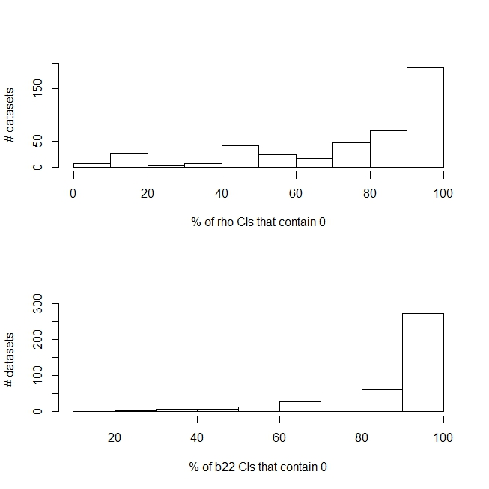
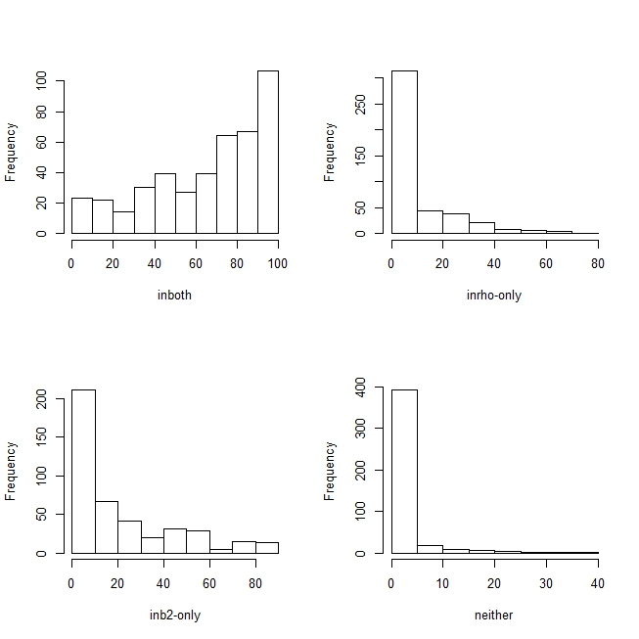
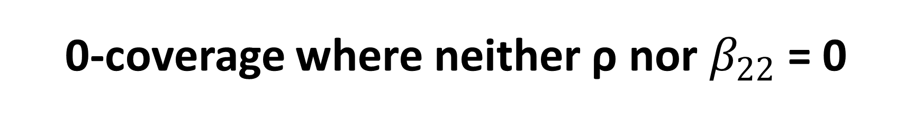
0-coverage where neither ρ nor $β_{22}$ = 0
Notes:
43,200 i.e. 66.24% contained 0 in both Cis.

Slide 78
More Results
Cases with longer time-series, large intercept effect sizes, and large autocorrelations had more correct Cis
Clearer data patterns are more powerful

Slide 79
Conclusion
We never know the “true” model
Do we have estimates that reasonably explain the pattern of the data?
Inflation of Type II error when choosing SA model
SA model underperforms even for time-series as large as 15 data points per phase and slope effect size of 1.

Slide 80
Conclusion
SI and NS models are preferred over the SA model.
Choose a priori if the model should include slopes or autocorrelations based on theory.
Emphasis on CIs and coverage rates.
RMSE is not an absolute criterion.
Impact on WWC standards.
Effect sizes for slopes.

Slide 81
Take-home messages
This is only the beginning of Bayesian
Work needs to be done on priors – sensitivity analysis
See priors as a source of including qualitative information and not as a nuisance
Often difficult to convince reviewers – sensitivity analysis
Future work: the conundrum of autocorrelation -> scale of the data -> rate ratio

Slide 82
Take-home messages
This is only the beginning of Bayesian
Work needs to be done on priors – sensitivity analysis
See priors as a source of including qualitative information and not as a nuisance
Often difficult to convince reviewers – sensitivity analysis
Future work: the conundrum of autocorrelation -> scale of the data -> rate ratio

Slide 83
Questions?
pnbatley@gmail.com

